Slide 1
Finding
Your
Audience
Who’s
Lola?

Slide 2
Stalking 101

Slide 3
Who am I?
What gives me the authority to give this workshop?
Ciara
Knight

Slide 4
Important
Disclaimer
This class is designed to help you identify your readers. This is my opinion based on my experience and research and tested on five thousand and twenty-two readers and cross referenced by fifteen thousand hours of reading and writing. However, you may have your own way of doing things and that is fine. Please note that there is not one formula for all writers and that is why this workshop is designed to help you self-identify your own readers.
Blah blah, blah blah blah. Blah and blah, blah, blah. Blah blah, blah blah blah. Blah and blah, blah, blah. Blah blah, blah blah blah. Blah and blah, blah, blah. Blah blah, blah blah blah. Blah and blah, blah, blah. Blah blah, blah blah blah. Blah and blah, blah, blah.
Blah blah, blah blah blah. Blah and blah, blah, blah.
No readers or writers were harmed in the making of this workshop.

Slide 5
Who & How
Why
Car
Rides
Lola
Purple
bows
Where
What

Slide 6
Genre/subgenre
Tropes and UFs
BISAC

Slide 7
Who & How
Belly rub?
https://bisg.org/page/BISACEdition

Slide 8
Genre/subgenre
Tropes/UFs
BISAC
Questions

Slide 9
Do you eat dinner at a table with family? ________________Yes, if I want scraps_____________
Do you enjoy cooking? _________________My paws get in the way______________________
Do you enjoy the outdoors or prefer to be at home? ___Outside_________________________
What are you reading right now? ________Puppies weekly____________________________
What are your favorite hobbies? ______________walking with my mom_________________
Are you mountain, beach, or dark dungeon type? ___________mountain___________________
What is your favorite toy/item/collectable?___chew toy_________________________
Do you mark up your books when you read? ______________When Mom isn’t looking._____
Where do you shop? ____________________Petsmart________________________________
Stop!

Slide 10
Genre/subgenre
Tropes/UFs
BISAC
Questions
Discover

Slide 11
Stalk Before You Talk
Not in a creepy way

Slide 12
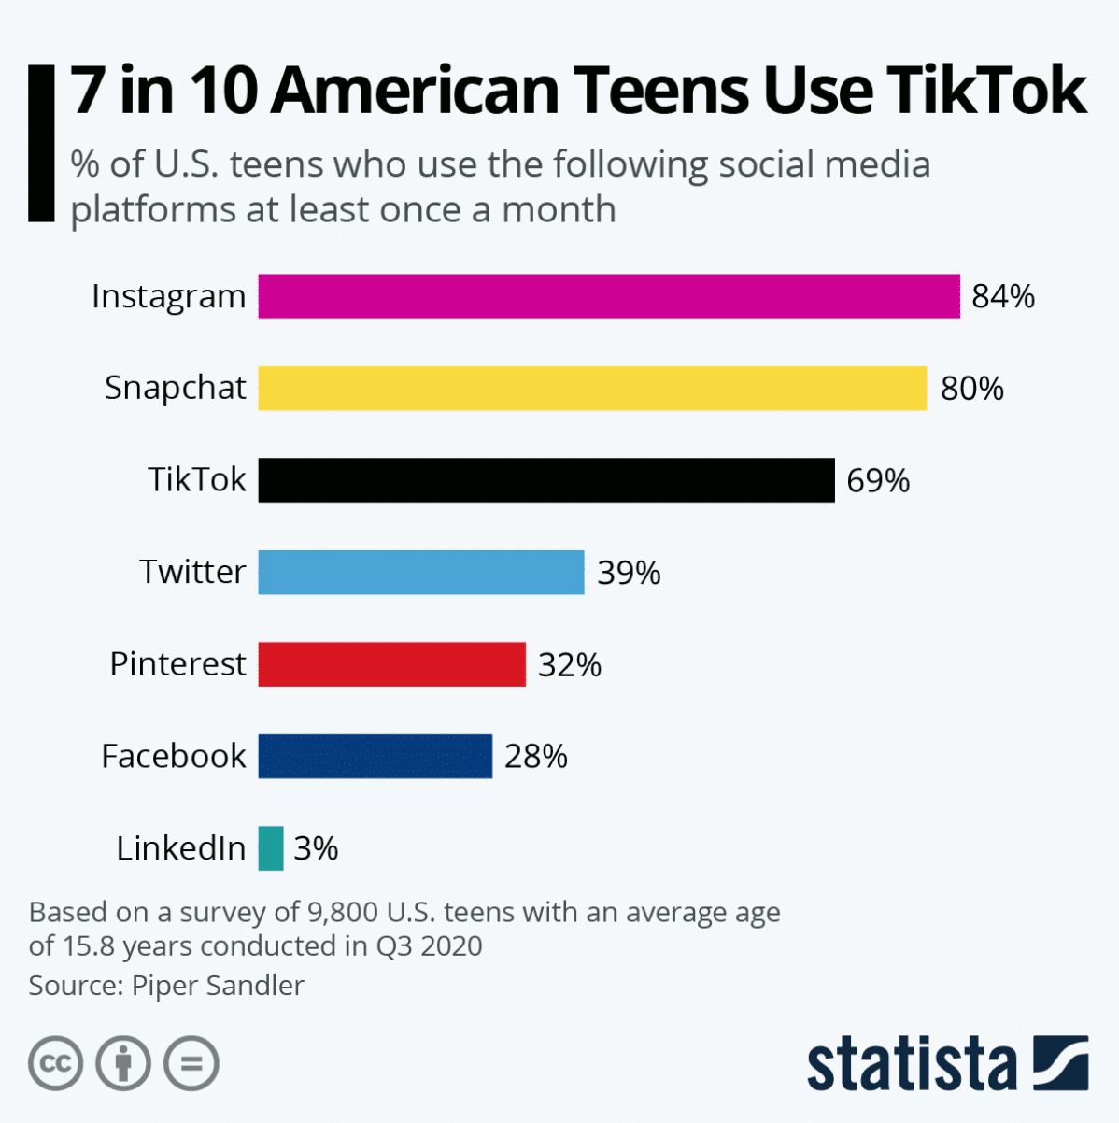
According to Statista the rank of the most
popular social media platforms are:
Facebook
Youtube
Instagram
TikTok
Pinterest

Slide 13
Genre/subgenre
Tropes/UFs
BISAC
Questions
Discover
Deep Dive

Slide 14
Social
Media

Slide 15
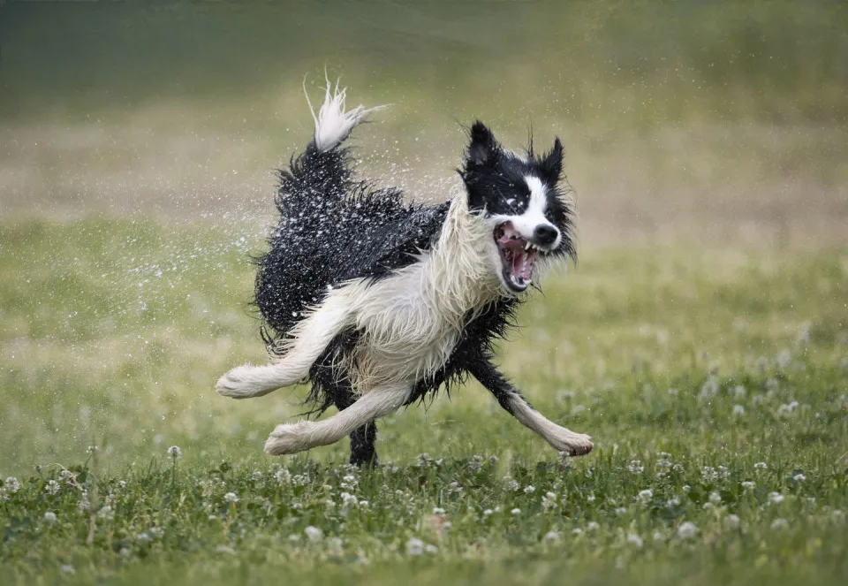
Creepy First Date
Brainstorm with friends on how to talk to her.
Ask Lola what she likes or there won’t be a second date!
**Consider your marketing approach
Based on your information. Figure out where you’ll best target your readers.

Slide 16
Genre
subgenre
BISAC
Questions
Discover
Keywords
Deep Dive

Slide 17
Keywords
Amazon search method
Kindlespy
Go through and pick out five keywords that are unique without as much competition as using genre and subgenre.

Slide 18
Genre
subgenre
BISAC
Questions
Discover
Keywords
Deep Dive

Slide 19
Other methods on how to find the who?
Add to the questions you have it is a running list!
Ask your readers (more on that later)!
Read reviews of your books or comp book reviews
Read comp books and make sure you are in the right place.
Other places to get info on users are Discord and other
Specific forums

Slide 20
Genre/subgenre
Tropes/UFs
BISAC
Questions
Discover
Keywords
Deep Dive
Branding

Slide 21
Branding
Mood
Genre
Subgenre
Colors
Covers
Copy
and so much more.
Take all information you’ve collected and use it in your branding.

Slide 22
Genre/subgenres
Tropes/UFs
BISAC
Questions
Discover
Keywords
Deep Dive
Branding
Marketing

Slide 23
Marketing
Content marketing
Social media marketing
SEO
Email Marketing
Pay Per Click marketing
Influencer Marketing

Slide 24
Content
Marketing
Don’t be a Diva
Loof at
me
A type of marketing that you utilize videos or images to promote your brand on platforms like TikTok, Facebook, Blogs, Website, Snapchat, Instagram, etc...
Without explicitly promoting yourself.

Slide 25
Social Media
Marketing
Interact with readers
Fun
House
To build brands, increase sales, and drive website traffic.

Slide 26
SEO
Sir
Sherlock
A comprehensive plan to get more visitors to your website through search engines.

Slide 27
Email
Marketing
Mr.
Shy
Direct marketing to a warm audience and hopefully building new readerships.

Slide 28
Pay Per Click
Pay each time someone clicks on your advertisement
Mr.
Money
Spots

Slide 29
Break it down
Kit
Kat
Where to begin.

Slide 30
Break down your customers into multiple segments
Top gross earners with least amount of work.
The longest Readers
who has bought all your books?
The easiest customers to work with.

Slide 31
Who to target!
Rock
Star
Who to run ads for:
Top gross earners that have a large audience still untapped.

Slide 32
Target on social Media
Ralph
Nana
Mrs.
Catnis

Slide 33
Don’t Target
Foster
Nonpaying super fans.

Slide 34
Things to ask yourself?
Is your brand on point?
Your story delivering your author promise?
Based on who you have identified do you believe that person will LOVE your stories?

Slide 35
Case Study #1
Ciara Knight
Genre: Contemporary Romance
Subgenre: Small town, sweet
Tropes/UFs: small town romance, boy next store, second chance romance
BISACs:
FIC027270 FICTION / Romance / Clean & Wholesome
FIC027380 FICTION / Romance / Later in Life
FIC042040 FICTION / Christian / Romance / General

Slide 36
Case Study #1
Answers to questions:
Lives in Northwestern United States Loves to knit and cook Shops at Walmart and Target Hangs out on Facebook Person who makes the purchase decision Large print style books Non-practicing Christians Loves Family Feeling Special and noticed | Empty nester Still working or recently retired NO cursing No sex on the page Trying new recipes Favorite author is Debbie Macomber along with…. Prefers calm over drama Virgin River and Sweet Magnolias Anne of Green Gables Hot Apple cider

Slide 37
Case Study #1
Keywords | Discover | Deep Dive
Clean and Wholesome | Facebook | Paula Dean
Knitting | Knitting clubs | Knitting baby hats
Debbie Macomber | Cooking | Small southern towns
Recipes | Comp Reviews show love of family | Baking cupcakes
warm drinks | My reviews: sweet with more conflict than Hallmark | Animal memes
Feeling Special and noticed

Slide 38
Case Study #1
Start over
Genre/sub | Tropes/UF | BISAC | Keywords | Discover | Deep Dive
Women’s romantic fiction | makeovers | Clean and wholesome | Friendship fiction | Comp: Kay Correll | Paula Dean
 | Second chance romance | workplace | Clean and wholesome | Talking about grand kids | Knitting baby hats
 | Enemies to lovers | Friendship | baking | Hope and heart | Cat memes
 | fish out of water |  | families | Faith based non-religious quotes | Baking cupcakes
 | Wounded character |  | Sweet and sassy | Inspirational | Silpat

Slide 39
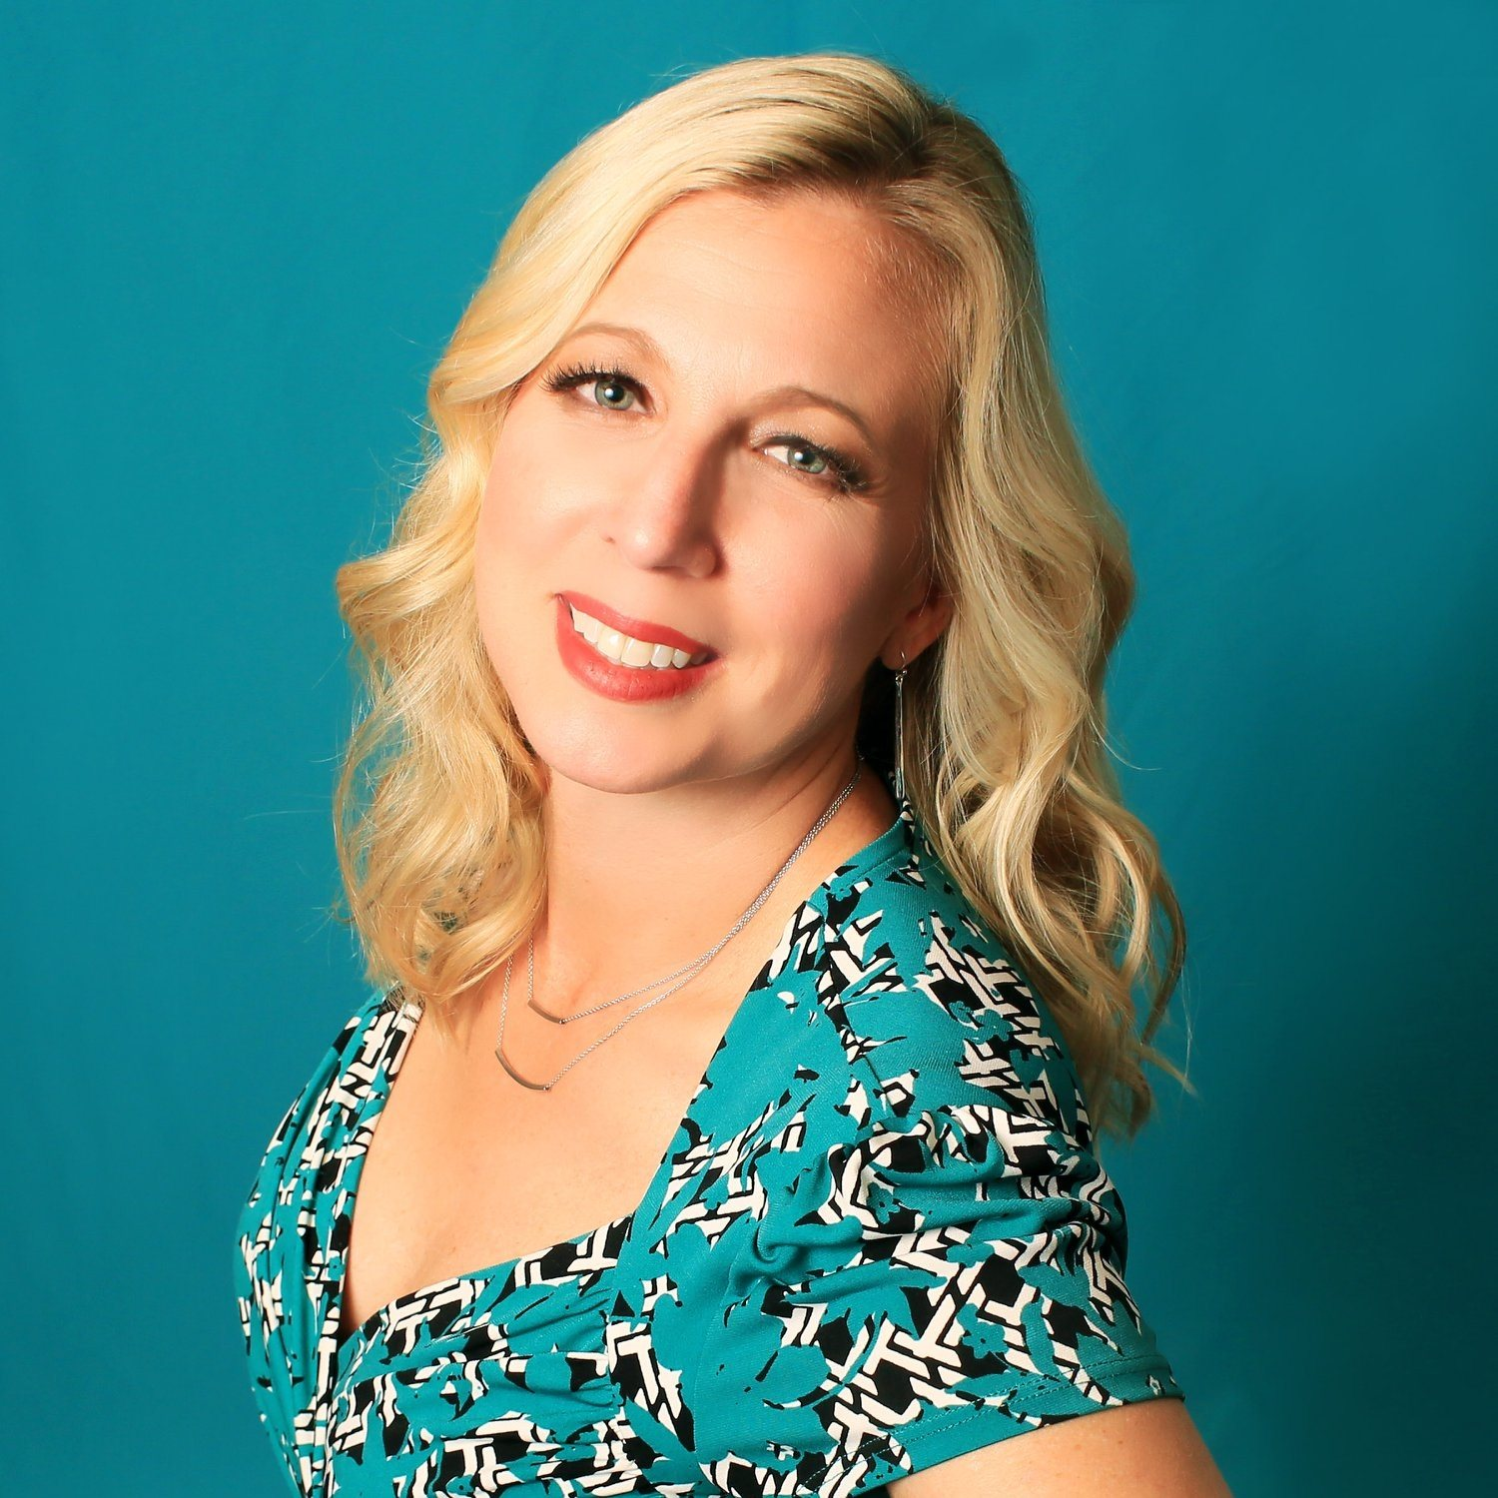
Case Study #1
Branding

Slide 40
Case Study #1
Marketing
Content marketing: Facebook, Instagram, and Pinterest Images produced by Book Brush about cooking and knitting and reading.
Social media marketing: Images and book trailer, quotes (short and long), free series starter offer, cover reveal (use puzzle creator), pre-order, and going live, continue with first in series posts
SEO Place key words into blog posts leading up to, during, and after launch. Include titles such as “Pleasing Pumpkin Pie” and “sweet and scrumptious beach treats”
Email Marketing: Be your own star campaign.
Pay Per Click marketing: Facebook utilizing keywords and hyper targeted.
Influencer Marketing: Not the best use of marketing time and energy at this time.

Slide 41
Case Study #2
Top Secret
Genre: Spicy Paranormal and Fantasy
Subgenre: witches, vampires, sorcery, magical realm, magical realism,
Tropes/UF: fated mate, Most popular guy chooses you, The bad guy who only loves you.
BISACs:
FIC027320 / Romance / Paranormal / Vampires
FIC027440 FICTION / Romance / Paranormal / Witches
FIC027030 FICTION / Romance / Fantasy

Slide 42
Case Study #2
Answers to questions:
12-50 y/o women Voracious readers Loves Halloween Loves family and friends Alpha fated heroes Magical realism | Spicy reads Tiktok Hooks using Ufs Coffee Escapism to other worlds Heroine making bad hero good

Slide 43
Case Study #2
Keywords | Discover | Deep Dive
vampires | TikTok | Streaming show
Tarot | Supernatural | Costumes and cosplay
Jennifer L. Armentrout | Jeaniene Frost | tattoos
Sara J Mass | Comp Reviews show lust, flesh, slow burn, | Broken souls
alcohol | Surprises | drama
Incognito curses online

Slide 44
Case Study #2
Start over
Genre/sub | Tropes/UF | BISAC | Keywords | Discover | Deep Dive
Fantasy adventure fiction | Torn apart by fate | Dragons & Mythical Creatures | Spicy, lust, and dark | Comp: Stacy Marie Brown | Vampires/shapeshifters, and pushing boundaries
Paranormal fantasy romance | Enemies to lovers | Dark Fantasy | Heroine tames hero | Talking about sex and alpha heroes | Shock factor
Fantasy romance | Fated to love | Action and adventure | Epic | Incognito curses | Drama and suspense
 |  |  | friends | Magical realism | Hooks and surprises

Slide 45
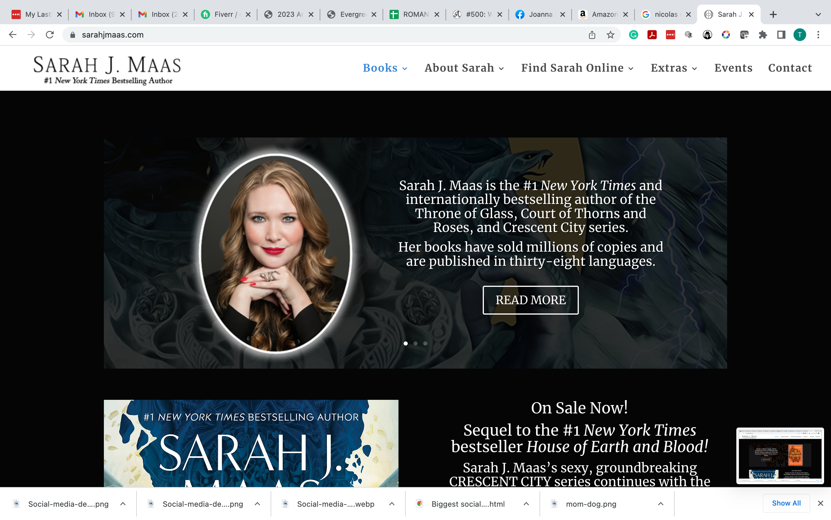
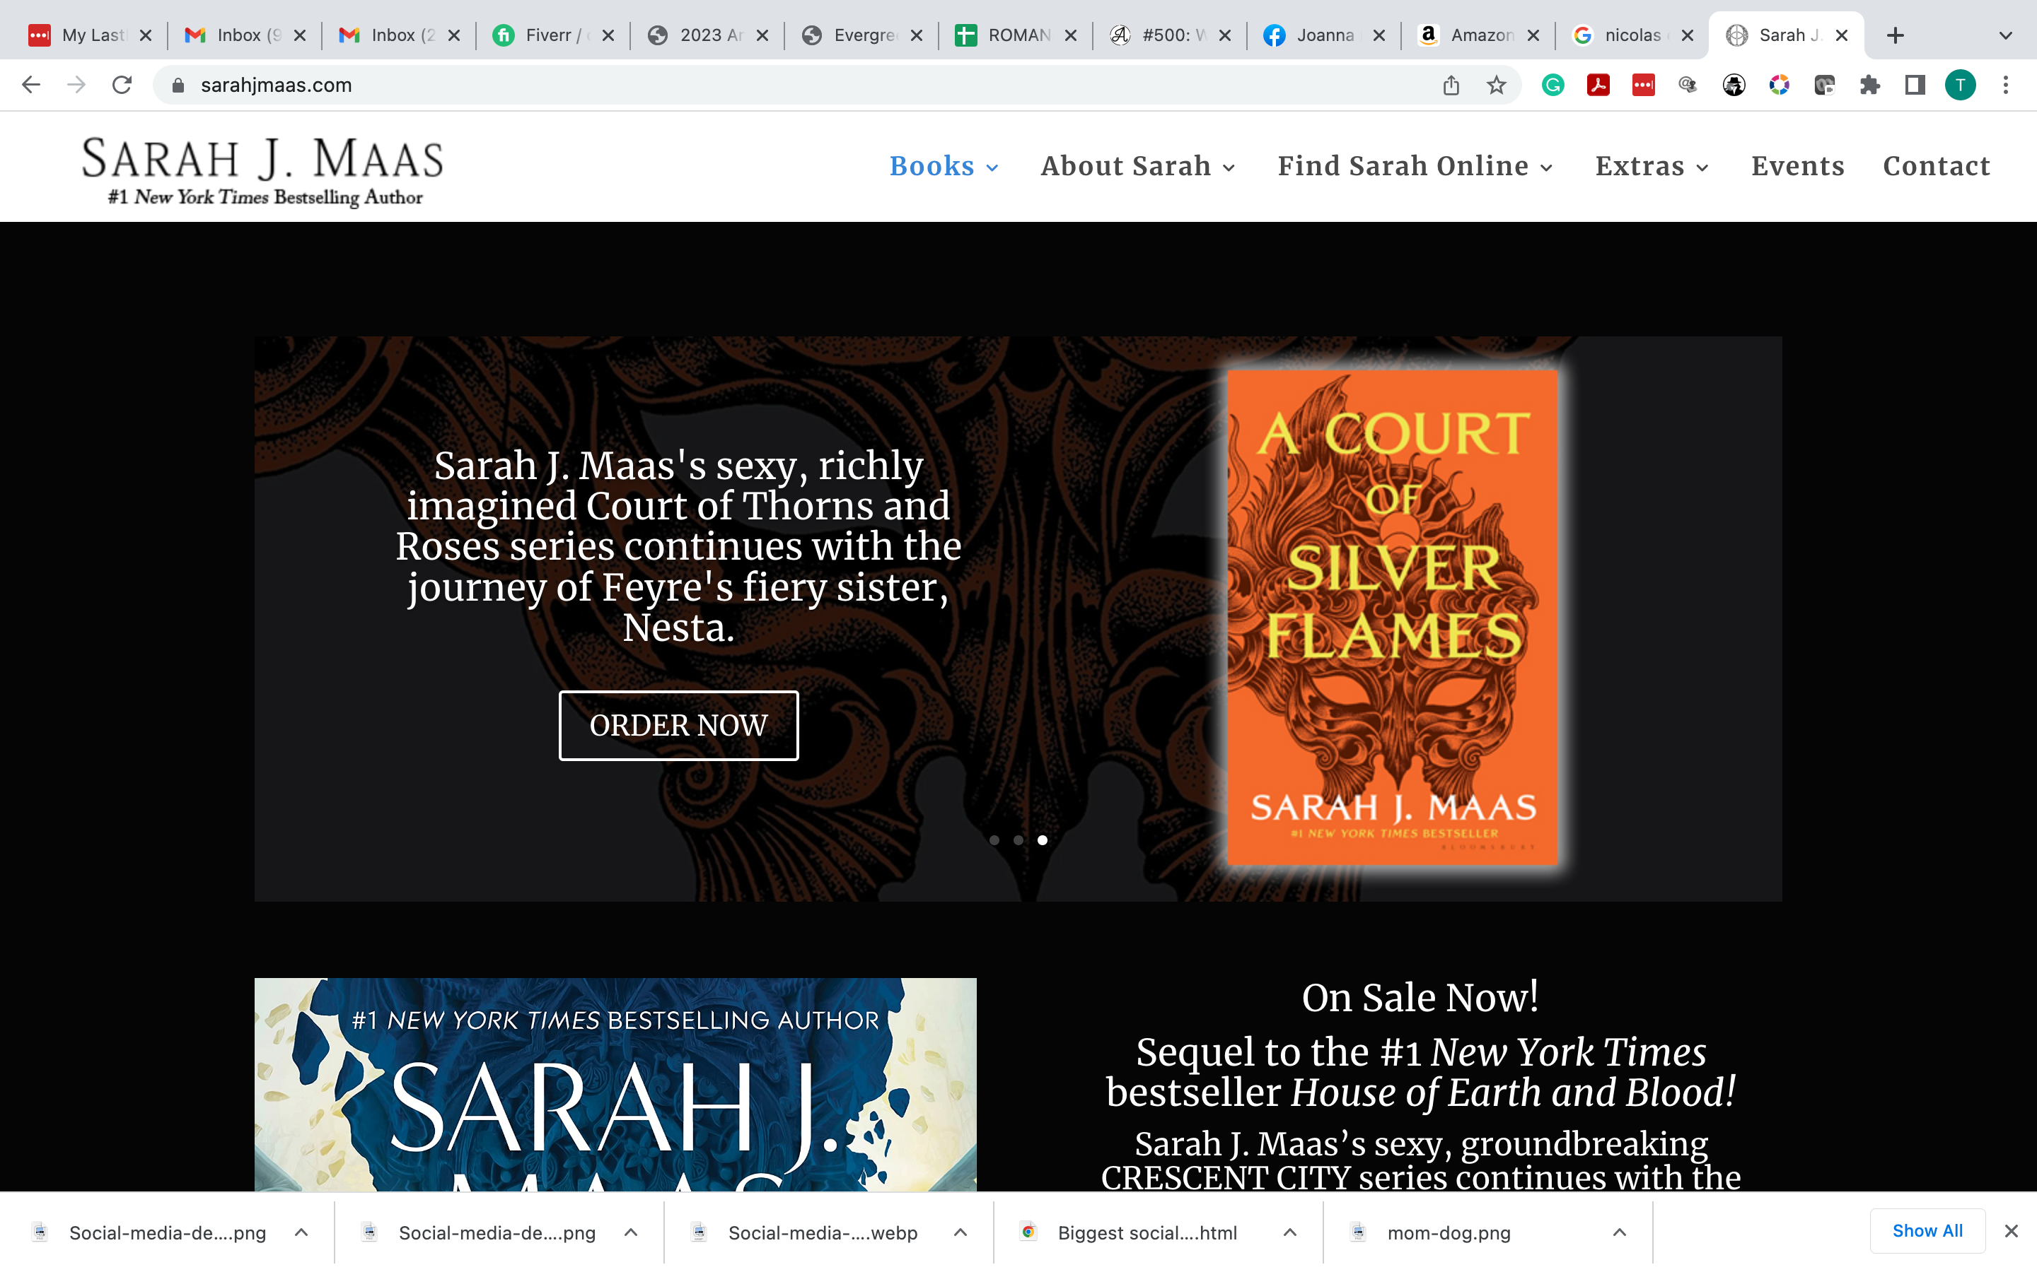
Case Study #2
Branding

Slide 46
Case Study #2
Marketing
Content marketing: Facebook, Instagram, and TikTok (on influencer account).
Social media marketing: TikTok (marketing account)
SEO: Images and book trailer, quotes (short and long) on FB, free series short story, cover reveal, pre-order, and going live, continue with first in series posts.
Email Marketing: Reader’s Pick for next story.
Pay Per Click marketing: AMS ads for KU books. No FB. Use budget for TikTok (marketing account)
Influencer Marketing: Tik Tok and reaching out to other Booktok reviewers and instagrammers.

Slide 47
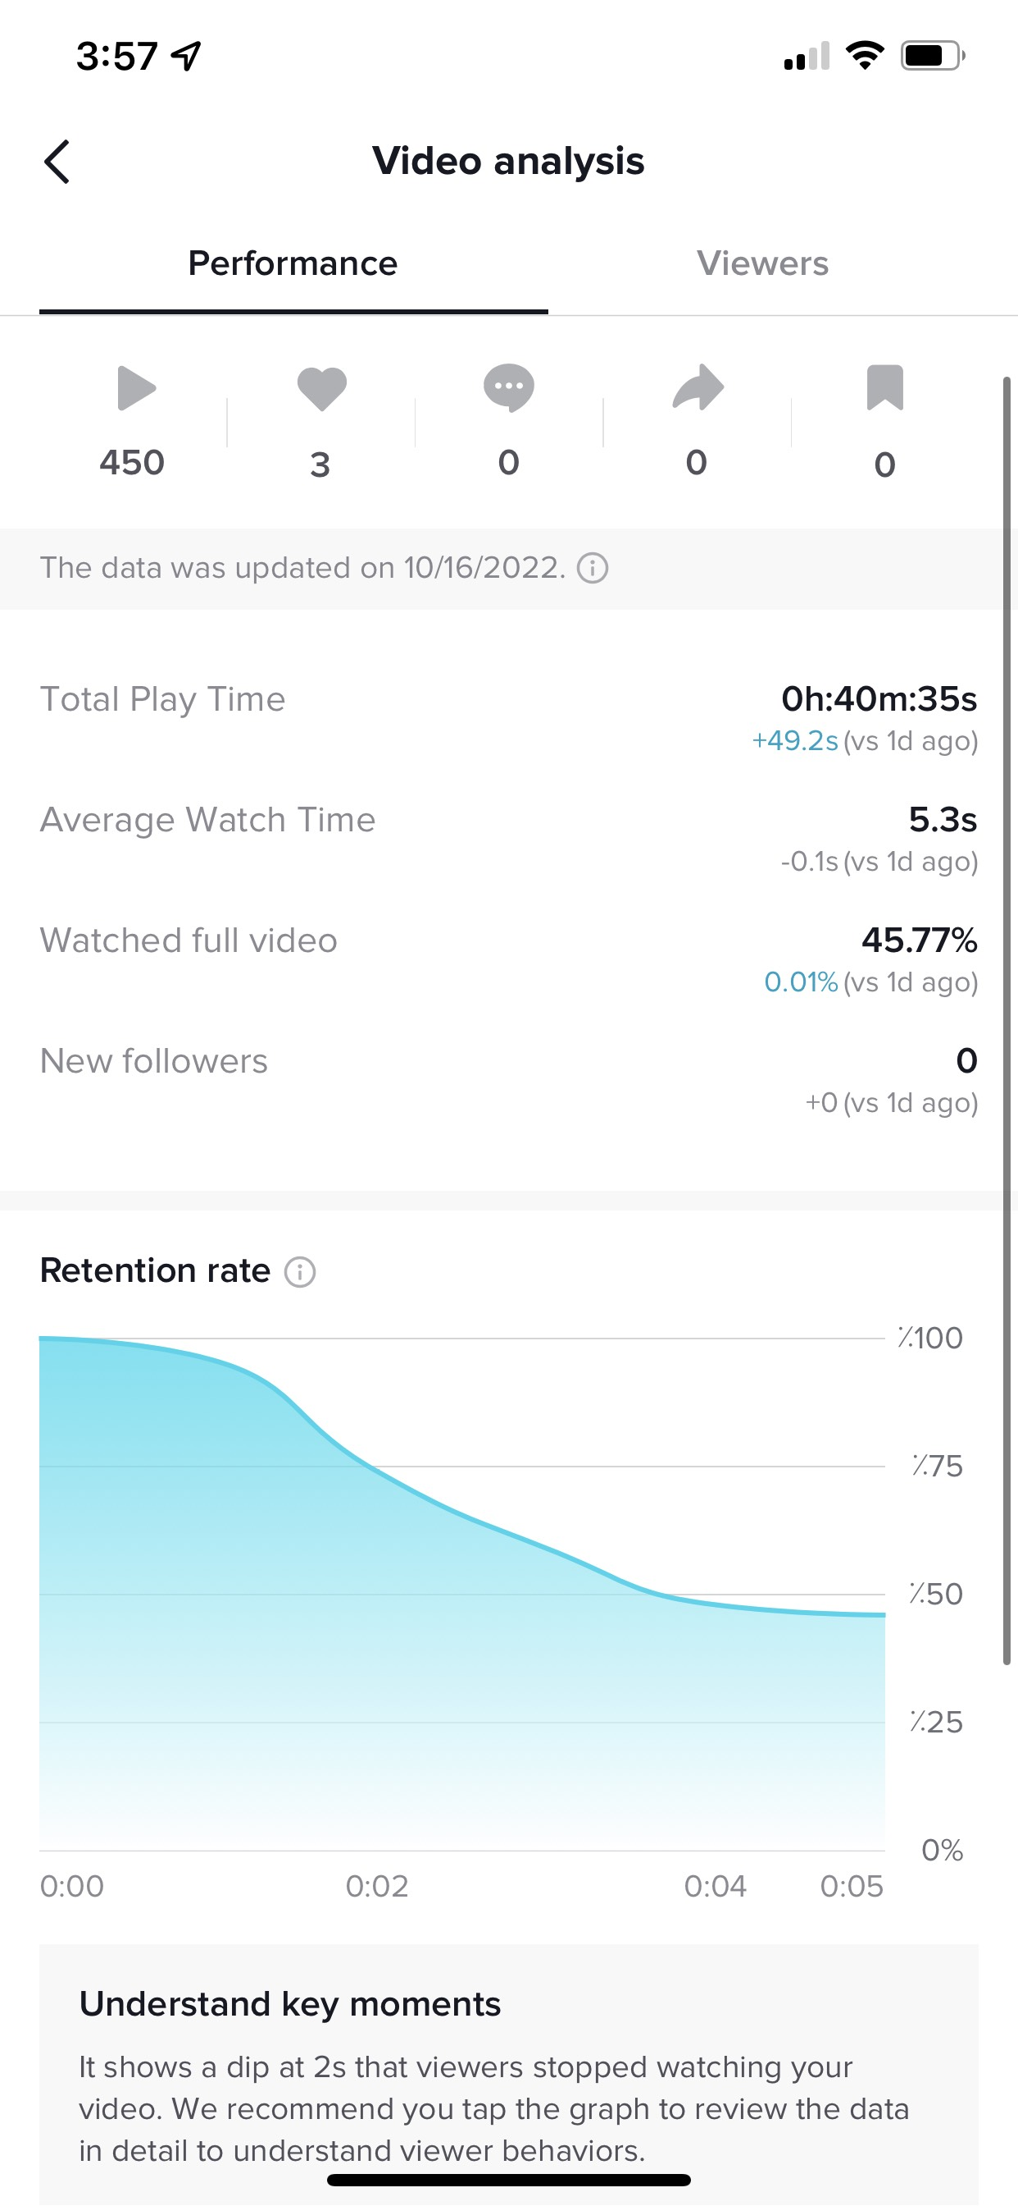
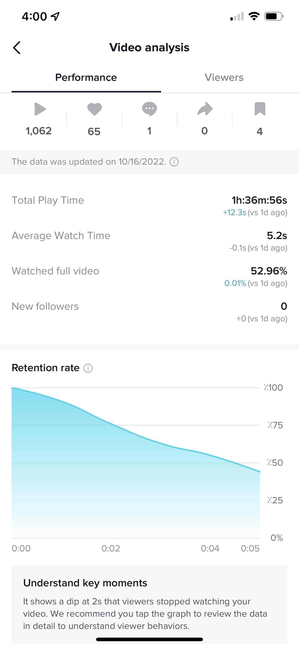
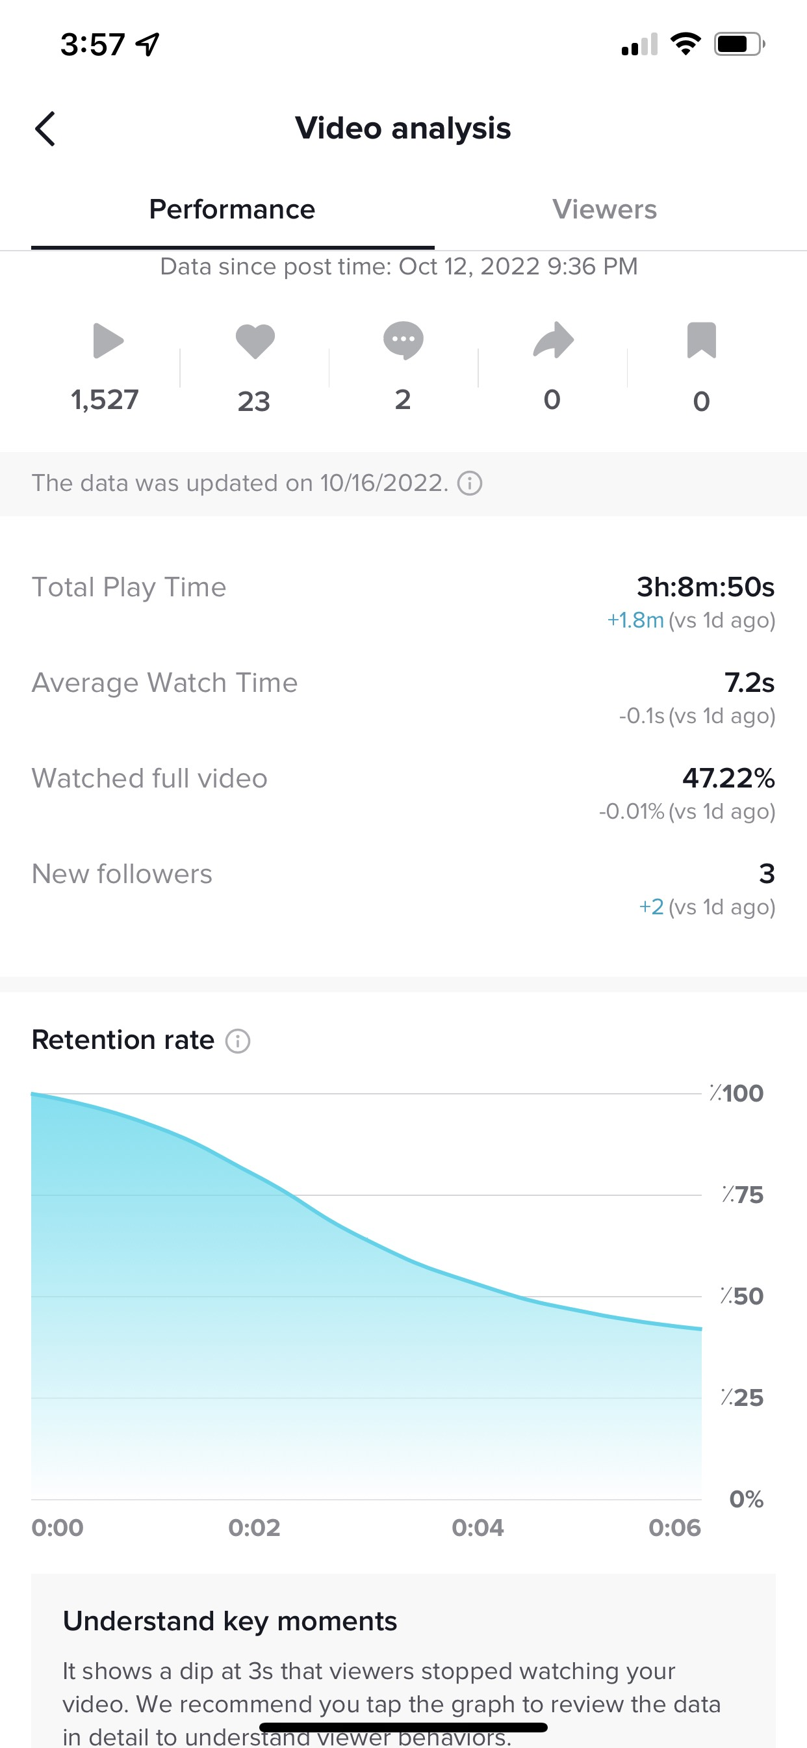
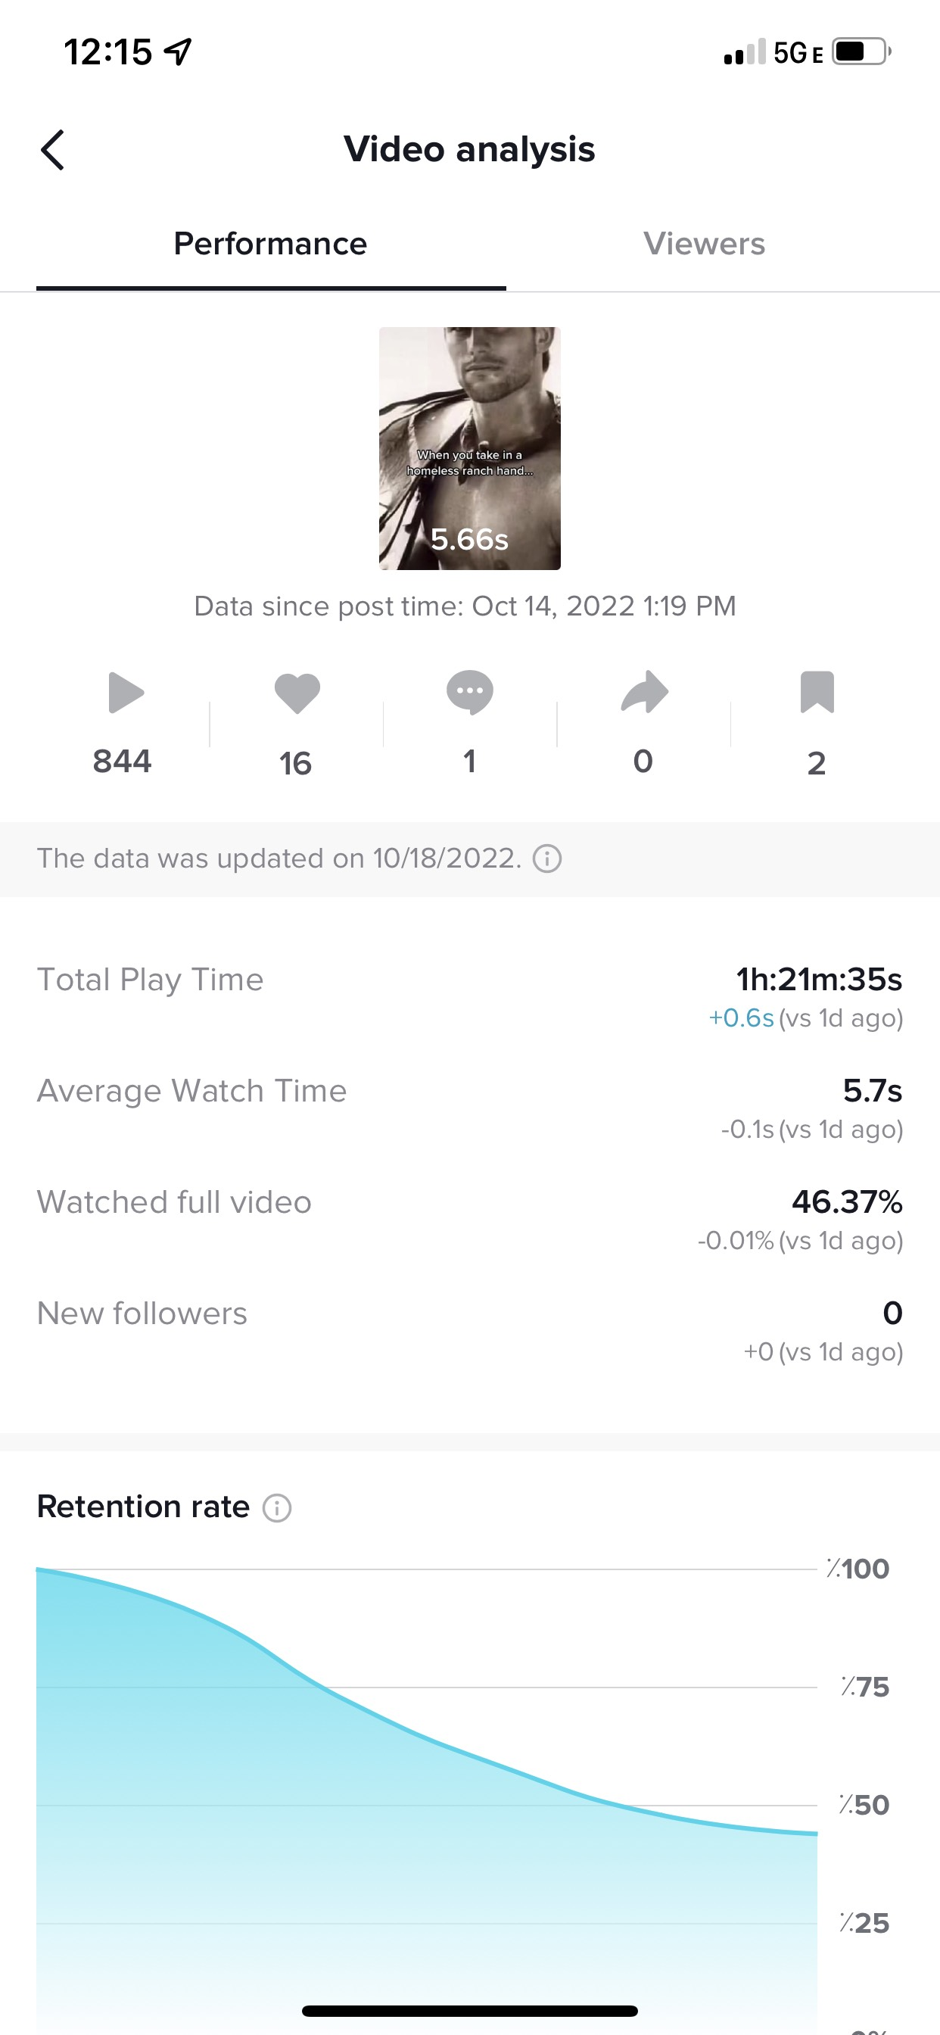

Slide 48
Bobby Kim
My Fb Group:
https://www.facebook.com/groups/gyptiktokmastery
My Youtube (start with this video) https://www.youtube.com/watch?v=MPQpIuOEZrA&t=710s
My Course Link: https://sso.teachable.com/secure/242287/checkout/4342270/grow-your-publishing-tiktok-mastery
I'll extend a discount code for people at the event: code is magnolia at checkout

